Slide 1
Implementation of Security Concept on Cloud Security
Christian Frans Mukuan Muladi Aprianto Manalu

Slide 2
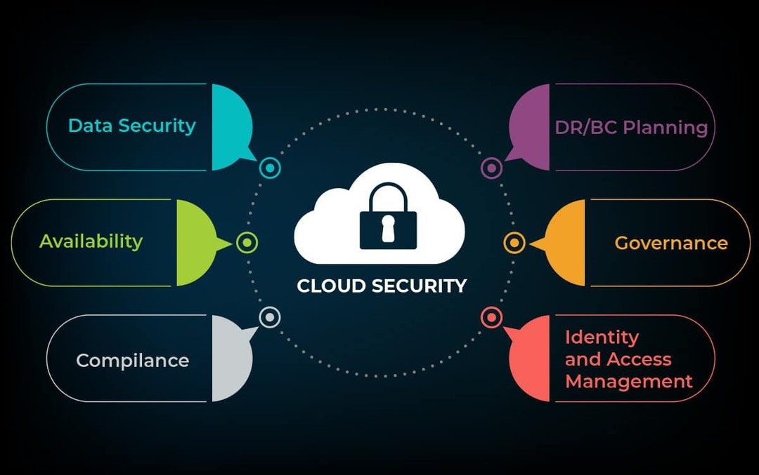
WHAT IS CLOUD SECURITY?

Slide 3
WORK FLOW CLOUD SECURITY

Slide 4
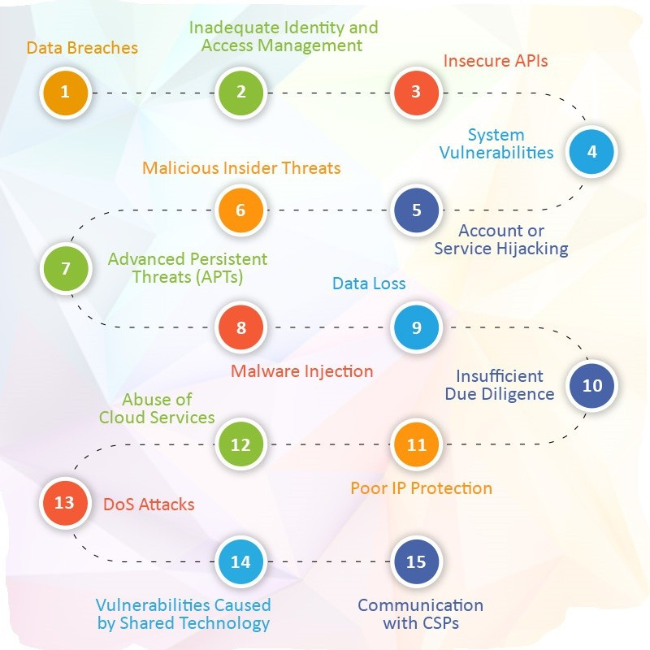
CLOUD SECURITY RISK AND ISSUES

Slide 5
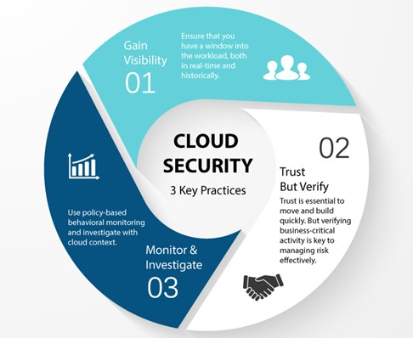
CLOUD SECURITY SOLUTION

Slide 6

ADVANTAGES AND DISADVANTAGES OF CLOUD SECURITY
Advantages
Protecting your business from threats
Guarding against internal threats
Preventing data loss
Disadvantages
Dependency on Internet Speed
Dependency on a Third Party
High Cost for Huge Data

Slide 7
The role of cloud based security solutions is to ensure that
customer’s information is safe at all
time. A cloud
service and
filters restricts
CONCLUSION
information
unwarranted access. It offers back up for the client’s information and offers data recovery in case of any data loss

Slide 8
THANK YOU!!!

